Slide 1
Going Live
Day 4
June 27th, 2016

Slide 2
Check-Up Session
How’s it going?
After 1 week of Bootcamp, how are you holding up?
What feedback do you have so far?

Slide 3

Instructor Feedback
Seriously, mind-blown.

Slide 4
Instructor Feedback
Things I’ve noticed people doing incredibly well:
All of you are handling an enormous volume of information…
All of you are asking the right questions…
Noticing the right details…
Helping others…
And, most importantly, you are figuring out things on your own

Slide 5
A Few Admin Things…

Slide 6
Instructor Feedback
Remember, Homework #1 is due on Wednesday!
Homework Link: www.bootcampspot.com
Remember to submit Homework via GitHub (and Heroku)
Github user names? Heroku covered today in class. You got this ☺
And seriously!
Submit whatever you have! Don’t get a 0.
(Even if you don’t like what you’ve made.)

Slide 7
Office Hours + Additional Help
Also, remember….
In Class Office Hours: 45 minutes before class, 30 minutes after
Slack questions time permitting – this has been very effective
One-on-one Google Hangouts on request
Review In Class Material (Exercises and Slides): https://github.com/UCF-Coding-Boot-Camp/06-16-VW-Class-Content/tree/master/0620-mw-class-content
Re-Watch Class Videos:
https://github.com/UCF-Coding-Boot-Camp/06-16-VW-Class-Content (You may need to scroll down a bit to see them)

Slide 8
Recapping

Slide 9

Recap – Class Read
In just one whirlwind week we’ve covered:
Full-Stack Development Conceptually
Terminal / Git Bash
HTML Syntax
Git Concepts and Commands
CSS Purpose, Syntax, and Styles
Floating
Positioning
Box Model
Google Dev Tools
How to learn on Your own!!

Slide 10
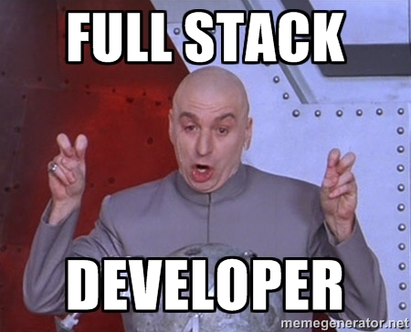
Full-Stack Development? What is it again?

Slide 11

> Intro to Console – so what do you think?

Slide 12


<title> Intro to HTML </title>
HTML is one of the three base languages behind every single website.
It defines all of the basic content and a bit of formatting.

Slide 13



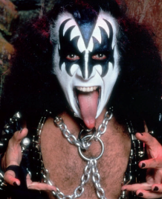
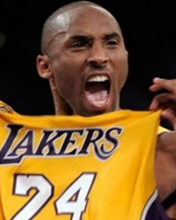
Pushing and Pulling to GitHub
1
2
3
4
GitHub Branch
Pull Code
Push Code
Pull Code
Pull Code
Push Code
Pull Code
Push Code

Slide 14

CSS Syntax
CSS works by hooking onto selectors added into HTML using “classes and identifiers”.
Once hooked, we apply styles to those HTML elements using css .

Slide 15

The Concept of “Flow”
In HTML/CSS, (by default) every element displayed is governed by a concept called “flow”.
This means that HTML elements force their adjacent elements to flow around them.

Slide 16
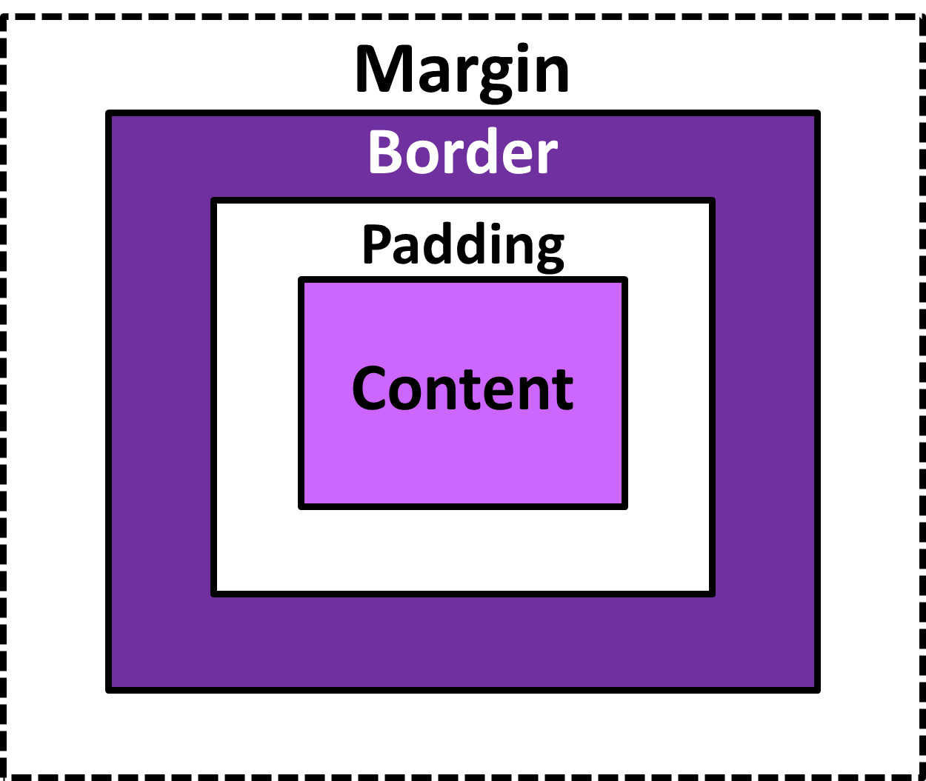
The Box Model
The Box Model wraps every CSS element in padding, border, and margin – allowing micro changes of spacing.

Slide 17

CSS Positioning
Through CSS positioning (static, relative, fixed, absolute) we can orient our html elements in relation to space.

Slide 18









How to Learn…

Slide 19

General Questions / Issues?

Slide 20
Double Take

Slide 21
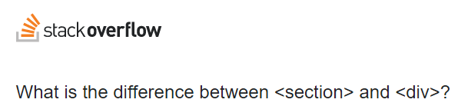
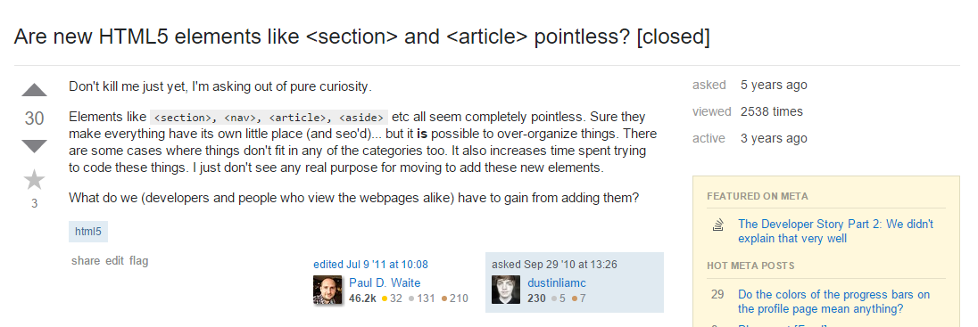
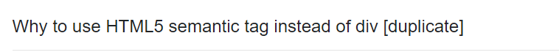
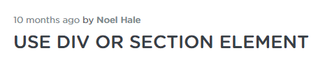
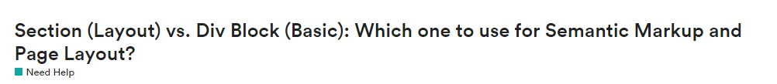
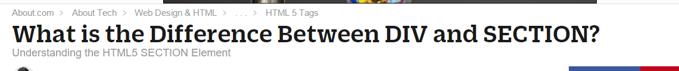
Divs, Sections, Navs, Etc….

Slide 22
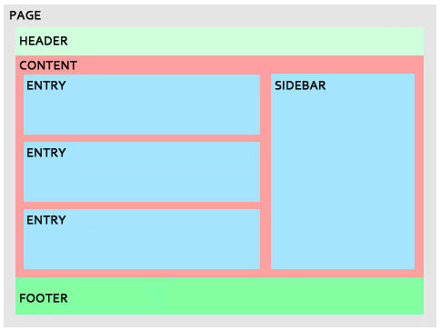
Divs, Sections, Navs, Etc….
Fundamentally, all web layouts are composed of containers, traditionally called “divs”.

Slide 23
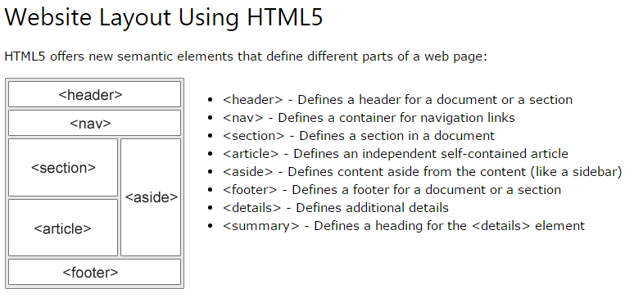
Divs, Sections, Navs, Etc…. a.k.a. ‘Semantic HTML’
HTML5 introduced the concept of “semantic layouts” meaning “divs” could be given more “meaningful names.”
In theory, this helps with organization and search engine optimization, but in all reality Google is more concerned with structured data so don’t get too hung up on semantic html – just know what it is because it may mature in the near future.

Slide 24
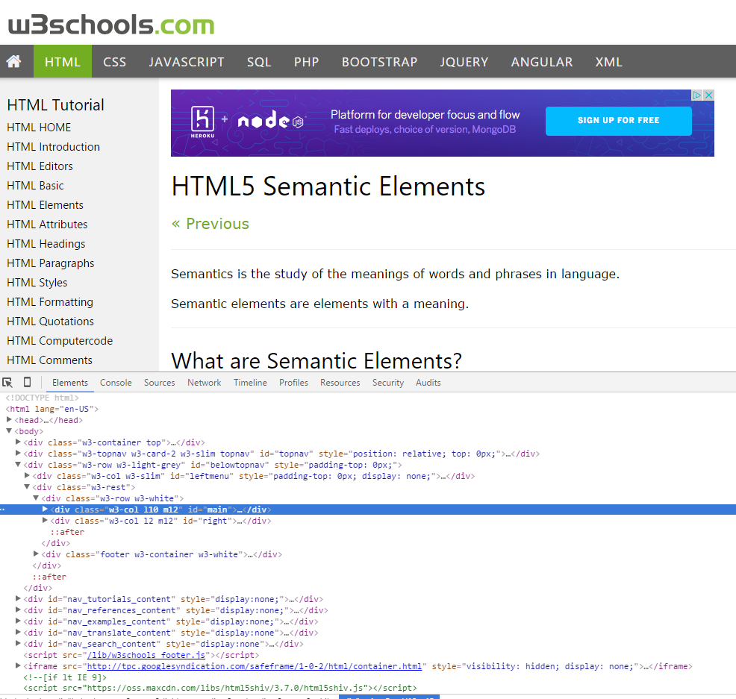
Divs, Sections, Navs, Etc….
That said… many (if not most) websites, seem to still be using basic divs.
There are reasons for this that we’ll showcase in later sections.
Additionally, it’s possible to include “semantics” by using id names and classes.

Slide 25
Divs, Sections, Navs, Etc….
div?
Section?
Bottom line: Follow your homework’s instructions. But when you get out in the “real world”, follow the convention of where you work!
SECTION = Has a natural <h1 – h6> Heading

Slide 26

Classes vs. IDs
Classes = Barcode (all IPod)
IDs = Serial Number (unique Ipod)
When choosing between a CSS ID and a CSS Class follow the convention:
Classes (.classname) are to be used if the same style will be used on multiple HTML elements
IDs (#idname) are to be used if a style is unique to that HTML element.

Slide 27
CSS Resets

Slide 28

Loading Multiple CSS Files ***(Very Important!!!)***
One of the most powerful aspects of CSS is the ability to deploy multiple CSS files simultaneously.
This allows developers the ability to create complex designs – made up of multiple design elements.
Just remember the loading order matters!!!

Slide 29
INSTRUCTOR DEMO!
Instructor: Demo
(1-3_CSSFiles.html | 1-MultipleCSS)

Slide 30
What Browser?
By a show of hands…
Which browser do you use?

Slide 31
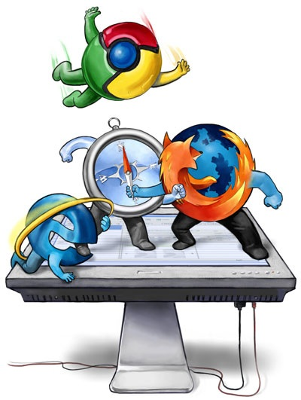
Battle of the Browsers
Under-the hood there are often significant differences between how browsers render webpages.
These differences in rendering agents can mean HTML/CSS gets displayed differently in each.
As designers/developers, creating cross-browser compatible websites is critical.

Slide 32

Reset.css (or Normalize.css)
Reset.css ensures that all browser-specific css has been reset, so it appears the same in all browsers.
This means you will have to re-style everything yourself

Slide 33
INSTRUCTOR DEMO!
Instructor: Demo
(Example.html | 2-ResetCSS)

Slide 34
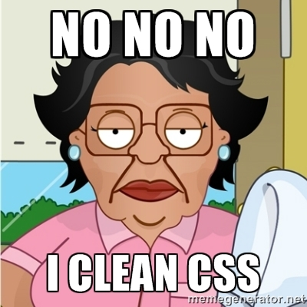
Why CSS Resets Matter
It’s important for creating browser-compatible websites
It’s an example of using someone else’s CSS in your website!!!
It’s a common Front-End Developer Interview question.

Slide 35
Why CSS Resets Matter
It’s important for creating browser-compatible websites
It’s an example of using someone else’s CSS in your website!!!
It’s a common Front-End Developer Interview question.

Slide 36
> YOUR TURN!!
Suggested Time: 10 min
Assignment
Follow the instructions given via slack to incorporate a reset.css file into a basic HTML file.
Note the impact the reset file makes after its inclusion.
If you have already done this, just show us and then help your neighbor through it.

Slide 37
Break – Ten Minutes (Clock’s ticking)

Slide 38
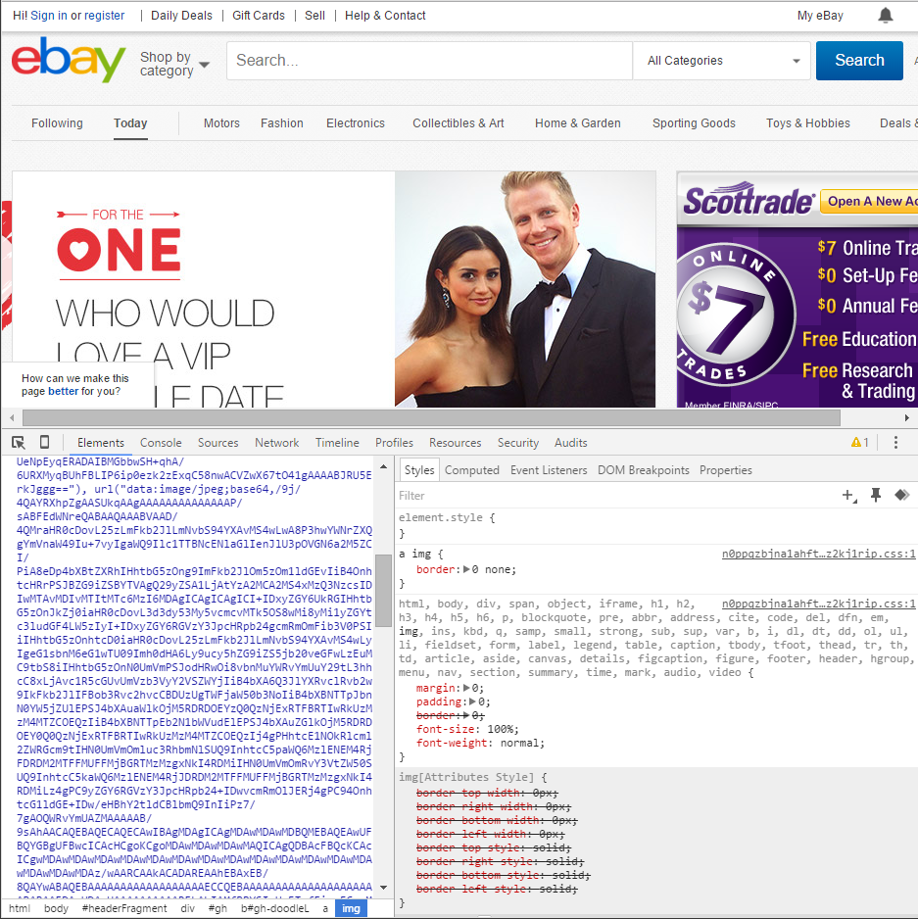
Google Developer Tools (Inspector)
GDT is one of the most frequent tools you will use in web dev.
It allows you to truly, debug your web designs.
Start using it!

Slide 39

Modifying Sites
Using Chrome Inspector you can readily edit any webpage (your own or otherwise) to see the immediate impact of HTML or CSS changes

Slide 40
INSTRUCTOR DEMO!
GDT Competition ready, set, …

Slide 41
Google Development Tool Competition!

Slide 42
Google Development Tools (GDT) competition
Round 1 – Setup
Teams – 6 teams of 4 (ish)
Whoever has the lowest (self-rated) GDT understanding at this time = presenter
2 min max per activity
Hand up when ready to present
Present solution on main screen (group effort)
Not eligible to present for rest of round but still participate and indicate when finished

Slide 43
Google Development Tools (GDT) competition
Round 1 – Number 1
Use https://google.com/
For all activities in both rounds.
Change the “Google Search” button to say “Froogle Search”

Slide 44
Google Development Tools (GDT) competition
Round 1 – Number 2
What is the background color of the bottom menu bar?

Slide 45
Google Development Tools (GDT) competition
Round 1 – Number 3
Change the body background to #1c4c80;

Slide 46
Google Development Tools (GDT) competition
Round 1 – Number 4
Change the display to emulate a Nexus 6P

Slide 47
Google Development Tools (GDT) competition
Round 1 – Number 5
Move the Google logo to the very bottom right of the main screen

Slide 48
Google Development Tools (GDT) competition
Round 2 Prep
Shuffle team members

Slide 49
Google Development Tools (GDT) competition
Round 2 – Number 1
Give the logo a margin of left (0px), right(10px), top(0px), bottom (10px) at the very bottom right of the screen

Slide 50
Google Development Tools (GDT) competition
Round 2 – Number 2
Change the gmail link at the top from https://gmail.com/ to https://nhl.com/ and update the label to NHL (From gmail)

Slide 51
Google Development Tools (GDT) competition
Round 2 – Number 3
Change “I’m Feeling Lucky” to
“UCF Bootcamp Code Heros”

Slide 52
Google Development Tools (GDT) competition
Round 2 – Number 4
Change the background color of the class now containing ‘UCF Bootcamp Code Heros’ to yellow

Slide 53
Google Development Tools (GDT) competition
Round 2 – Number 5
Using the previous number “Change the background color of the class now containing ‘UCF Bootcamp Code Heros’ to yellow” …
Now move that to the very left side of the screen.

Slide 54
Google Development Tools (GDT) competition
Game Over!
Great Job!
Your turn (Slack Instructions Now ☺)
(on your own website)

Slide 55
To the Web with Heroku!

Slide 56
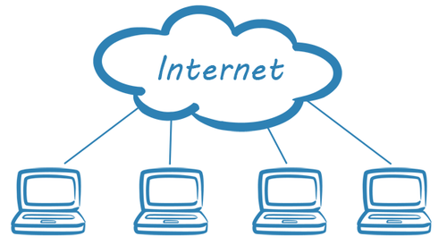
The Internet
A deep and complex diagram above on how the internet works.

Slide 57

The World Will See Our Greatness!
Heroku provides a cloud application hosting platform – which means we can deploy our websites and applications onto their servers for the world to see.

Slide 58
Together Now…
Let’s all login to Heroku

Slide 59
INSTRUCTOR DEMO!
Instructor: Demo
Video: E:\UCF\videoheroku-setup.mp4
Follow along on handout
Eyes on screen or paper
No typing or talking for 7 minutes ☺

Slide 60
Deploying Static Websites to Heroku
Basic Steps (handout and UCF guide):
Go to folder you want to host (must be .git enabled)
Add a file called composer.json and include an empty bracket {}.
Add a file called index.php with the following inside:
Run Heroku login (for windows users, remember the workaround!)
Run git remote –v
Run heroku create
Run git remote –v
Run git push heroku master

Slide 61
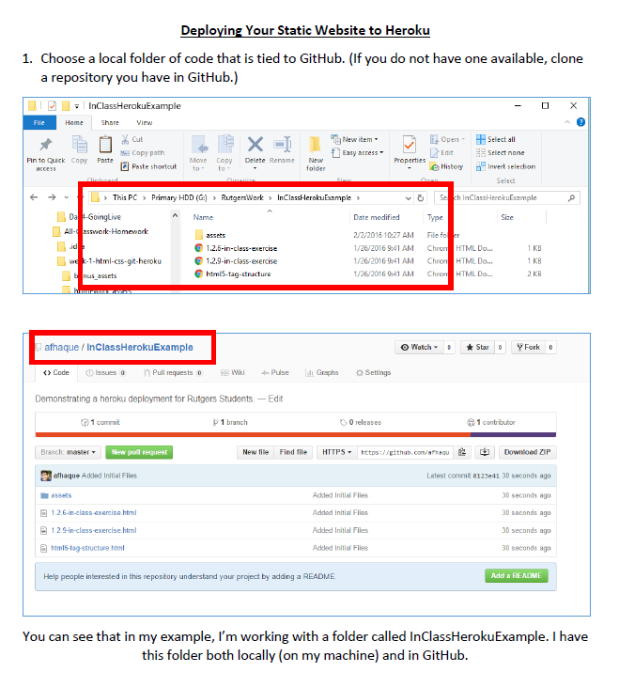
Follow our Guide!
Step-by-step guide on creating Heroku Deployments

Slide 62
> YOUR TURN!!
Suggested Time: 30 min
Assignment
Time to take your newfangled website and deploy it to the cloud. Setup your own instance of Heroku and deploy one of your HTML creations to Heroku.
Additional instructions to be sent via Slack.

Slide 63
Practice Through Frustration
Keep Practicing!
It gets better.

Slide 64
Questions?

Slide 65
Homework 1 - Help?

Slide 66
EXTRA MATERIAL

Slide 67
And Back to Git…

Slide 68

The Group Project
OMG. I HAZ THE GREATEST HTML IDEA!!!!!
SpongeSite.com

Slide 69

The Group Project
Programming Away…
Spongebob’s idea is dumb. We should call it…
PrincezzzSite.com

Slide 70
The Group Project
The Group Project – Tragedy #1
Programming Away…
Now they have two completely different versions.
Programming Away…

Slide 71
The Group Project – Push vs Pull
Main Branch (Spongebob’s)
Spongebob continues programming
1
2
3
4
5
This is NON-IDEAL
Prince pushes his code changes into the main branch.
If Prince is allowed to push his code, it could seriously ruin Spongebob’s vision and working code.
Prince’s Branch

Slide 72
The Group Project – Push vs Pull
Main Branch (Spongebob’s)
Spongebob continues programming
1
2
3
4
5
Prince’s Branch

Slide 73
The Group Project – Push vs Pull
Main Branch (Spongebob’s)
Spongebob continues programming
1
2
3
4
5
Ideal Approach – Using Pull Requests
Because Spongebob controls the “master branch” he must elect to pull Prince’s Code. All Prince can do is submit a “pull request”
This is the ideal way to maintain code in version control.
?
Prince’s Branch

Slide 74
General Steps for Git Pull Requests
Create a new branch of on your local computer git branch <BRANCH NAME>
Checkout that branch (locally) on your machine git checkout <BRANCH NAME>
Add / Commit your changes (will automatically save to this branch) git add –A git commit –m “Comment”
Push your branch to GitHub
git push origin <BRANCH NAME>
Submit a Pull Request on GitHub
Other user must accept these changes on GitHub

Slide 75
INSTRUCTOR DEMO!
Git Pull Request

Slide 76
> YOUR TURN!!
Assignment
Time to take your newfound collaborative git skills to the real-world. Find a partner and follow the steps sent via slack to
Share each other’s code
Make modifications
Submit a Pull Request
Accept the Pull Changes

Slide 77
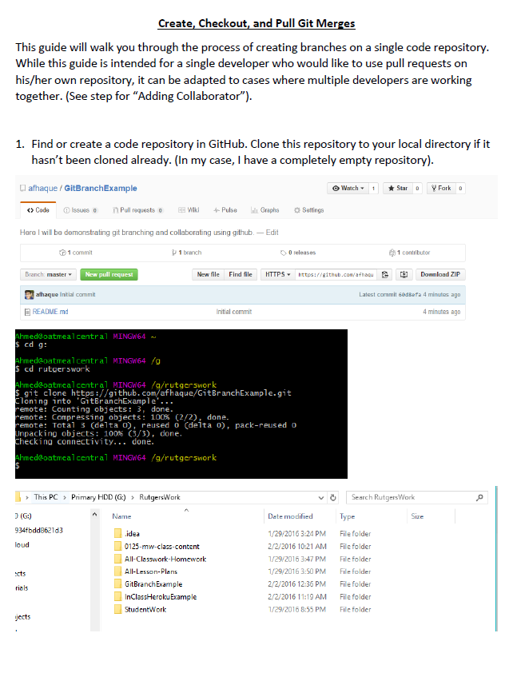
Follow our Guide!
Step-by-step guide on creating Git Pull Requests

Slide 78
Don’t Worry!
We’ll be coming back to this.
You won’t need this fully until Week 8.

Slide 79
Practice At Home
But practice when you can!
You don’t need a partner to submit pull requests

